Slide 1
Canaanite Period
Canaan indicates a region in and around the geographical area of modern Israel
Canaanites refer to ethnic groups of people in the region
Begins in Early Bronze age, prior to written records
Ends as Israelite remains become distinct

Slide 2
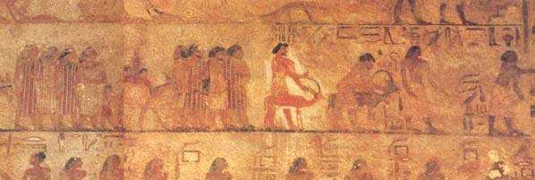
Beni Hasan Mural
Biblical Archaeology Review 21:3, May/June 1995
10 Great Finds
In one of the tombs, dating to the early 19th century B.C.E., is a large painting (below) 8 feet long by 1.5 feet high, showing eight men, four women and three children in a procession led by two Egyptian officials.
Although the mural has been frequently used to illustrate the lifestyles of the Israelites’ ancestors—as described in Genesis—many details of this scene remain unclear.

Slide 3
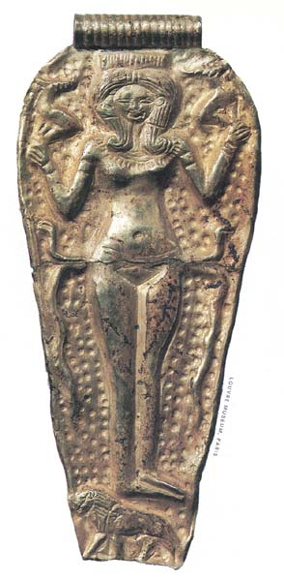
Fertility Goddess Pendant
This gold pendant was found in a princess’s tomb in Minet el-Beida, Ugarit’s port city. It resembles the many thousands of nude goddesses in diverse forms and media found throughout the Levant.
Discoveries such as this pendant remind us that Israel was very much a part of the Levant, rather than a separate entity. As Ezekiel put it, “By origin and birth you are of the land of the Canaanites” (Ezekiel 16:3).
Biblical Archaeology Review 21:3, May/June 1995
10 Great Finds

Slide 4
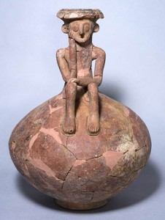
Pottery with Sculpture of a Canaanite Man 1800 BC
This 3,800-year-old clay jug with a figurine resembling French artist Rodin’s famed sculpture The Thinker was discovered in the Israeli town of Yehud, near Tel Aviv in 2016. Photo: Clara Amit.
Bible History Daily
11/30/2016

Slide 5
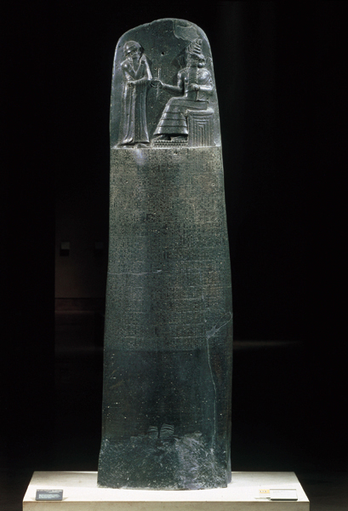
The Code of Hammurabi 1792–1750 BC “An Eye for an Eye”
Law #196
“If a man destroy the eye of another man, they shall destroy his eye. “
Deuteronomy 19:21
“Thus you shall not show pity:
life for life, eye for eye, tooth for tooth, hand for hand, foot for foot.”
Bible Review 15:1, February 1999
“Proclaim Liberty Throughout the Land”

Slide 6
The Divided Land
As delineated in Genesis, Canaan included a northern pasturage area (in green) centered on Shechem and southern pastures (in orange) surrounding Hebron and Beersheba. The Jordan River and the Dead Sea formed the eastern border (Numbers 34:12).
When Abraham offered Lot his choice of portion of “the whole land,” Abraham was referring to Canaan as “the whole land.” But Lot, “seeing that the plain of Jordan was well watered everywhere like the garden of the Lord” (Genesis 13:10), chose to settle among the Cities of the Plain. Scholars have suggested that they lay either beneath what is now the southern Dead Sea or just to the southeast (in red). In either case, the Bible clearly states that they were not part of Canaan: “Abraham settled in the land of Canaan, while Lot settled among the Cities of the Plain and moved his tent as far as Sodom” (Genesis 13:12).
Bible Review 11:5, October 1995
Abraham’s Eight Crises

Slide 7
Canaanite Cities
During the second millennium B.C., the population of Canaan—the land west of the Jordan River, according to Egyptian and Akkadian sources of the time—lived mostly in cities, which had been in existence from the beginning of the second millennium B.C. until their destruction during the course of the 12th century. These cities were strongly fortified and ruled the countryside surrounding them. Beginning in about the middle of the second millennium B.C., however, these city-states began to decline. For the most part, their fortifications were gradually abandoned.
Biblical Archaeology Review 28:4, July/August 2002
Israelites and Canaanites

Slide 8
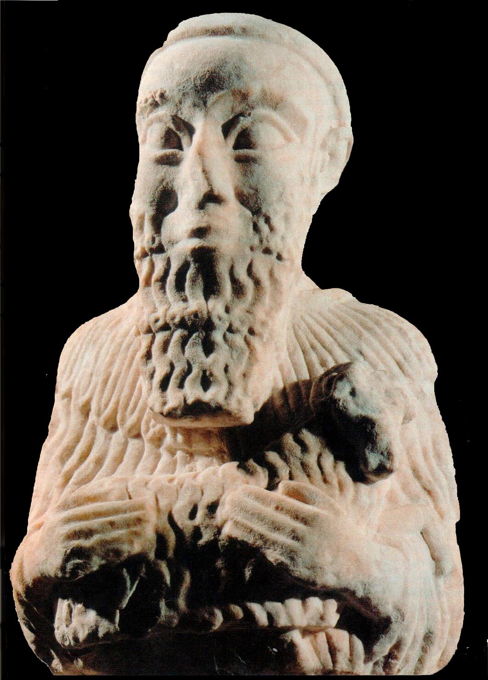
Man Carrying Sacrificial Lamb 18th Century BC
Genesis 22:8
“Abraham said, ‘God will provide for Himself the lamb for the burnt offering, my son.’”
A statue recovered at Mari depicts a man carrying a sacrificial lamb. Among the customs shared by the peoples of Mari and early Israel, Malamat says, was the sealing of a covenant with the sacrifice of an animal. In Genesis, Abraham often sacrifices an animal when making a covenant, and the Mari tablets attest to a similar practice in that city.
Biblical Archaeology Review 29:1, January/February 2003
The History Behind the Bible

Slide 9
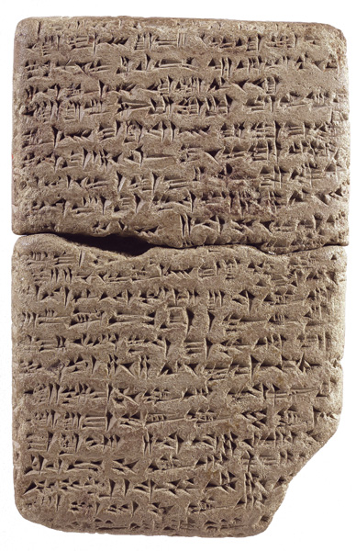
El-Amarna Letters 1350 BC
This tablet (catalogued as EA 289) and several others were sent to the pharaoh by ‘Abdi-Heba, the ruler of Urusalim (Jerusalem), indicating that there was a significant city at the site in the 14th century B.C.E. However, excavations in Jerusalem have produced only meager finds, leading some archaeologists to conclude that Jerusalem was merely a small outpost or fortified estate during the Late Bronze Age, rather than a flourishing city.
Biblical Archaeology Review 35:1, January/February 2009
The Trowel vs. the Text

Slide 10
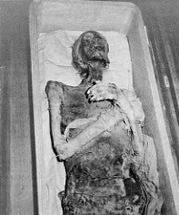
Pharaoh Rameses II 1279 – 1213 BC
Exodus 1:8-9
“Now a new king arose over Egypt, who did not know Joseph. He said to his people, "Behold, the people of the sons of Israel are more and mightier than we…”
In 1983, Many scholars believed Ramesses II was one of the Pharaohs who oppressed the Israelites. They cited a reference to Israel in a steleb commemorating the military victories of Merneptah, Ramesses II’s son, who ruled immediately after him (c. 1223 B.C.–1213 B.C.). The reference reads, “Plundered is Canaan. Israel is desolated; his seed is not. Palestine is become a widow for Egypt.”
Biblical Archaeology Review 9:1, January/February 1983
BAR Jr.: Gamma Rays Halt Deterioration of Mummy of Ramesses II

Slide 11
The Egyptian Name of Moses Mose, “The Child”
Exodus 1:10
“Pharaoh’s daughter named him Moses, saying, “I drew him out of the water.”
The liberator of the Israelites shared the name Mose, “the Child,” with a 13th-century B.C.E. scribe, shown twice in a wall relief from his tomb in Saqqara. On the left Mose holds his reed pen and writing palette; at center, he appears again, standing before the goddess at right. Mose, by itself, was not a common name in ancient Egypt; it was much more frequently appended to names of deities to form compound names like Thutmose, which means “Thoth is born,” or Ramose, which means “Ra is born.”
Bible Review 19:3, June 2003
Moses’ Egyptian Name

Slide 12
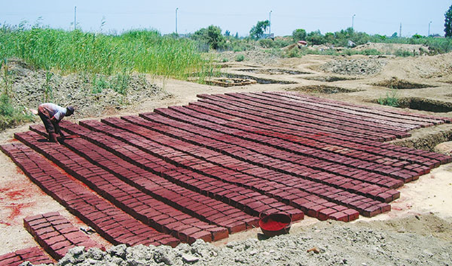
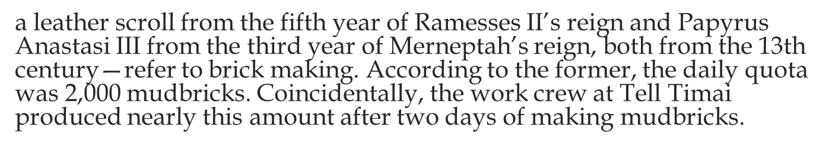

Exodus 5:18
Pharaoh:
“So go now and work; for you will be given no straw, yet you must deliver the quota of bricks.”

Slide 13
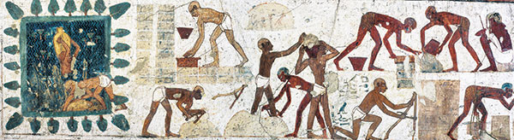
Anastasi Papyri
Nubian and Semitic slaves mix water and mud to create mudbricks while a seated Egyptian official (upper right) oversees their work.
Two other papyri (Anastasi IV and V) report that “there are no men to make bricks and no straw in the district,” stressing the importance of straw in brick manufacturing.
We also conducted an experiment: We made some bricks without straw. We used the same process to manufacture the mudbricks but left out the straw chaff. The bricks without straw were fragile and broke easily
Biblical Archaeology Review 40:2, March/April 2014
With & Without Straw: How Israelite Slaves Made Bricks

Slide 14
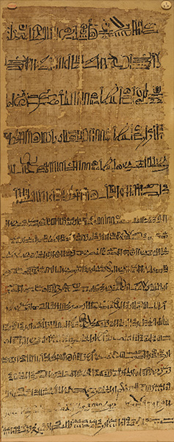
Anastasi Papyri
Papyrus Anastasi VI records how a group of Shosu Bedouin from Edom was given permission to pass an Egyptian stronghold and to water its flocks by the lakes of Pithom in Egypt. It dates from the fifth year of Sethos II (c. 1209 B.C.E.). Emerging Israelites may well have done the same thing.
Biblical Archaeology Review 42:3, May/June 2016
Exodus Evidence: An Egyptologist Looks at Biblical History

Slide 15
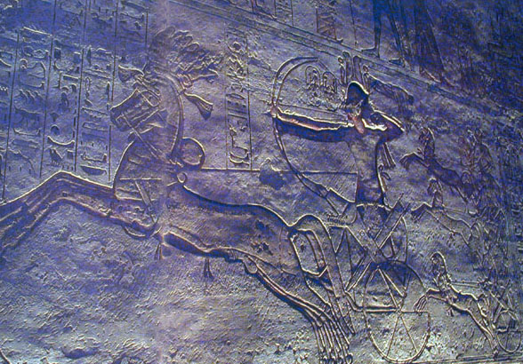
Ramesses II
Riding tall in his chariot, the Egyptian pharaoh Ramesses II plunges into battle in this monumental relief from the Great Temple at Abu Simbel. The Battle of Kadesh
Bible Review 16:6, December 2000
The Divine Warrior in His Tent
Using pictorial and literary evidence from this and other reliefs, author Michael Homan describes the remarkable similarities between the Israelite Tabernacle. Literary texts in ancient Egypt and Israel use similar language to describe, respectively, the pharaoh and Yahweh as divine warriors. Like the pharaoh’s war tent, the Tabernacle may have been regarded as a mobile military headquarters from which Yahweh, traveling before the advancing Israelite tribes, led his people.

Slide 16
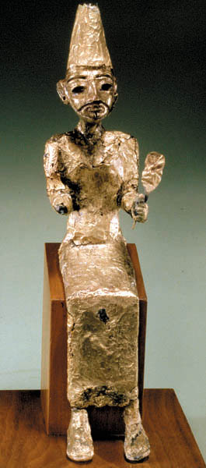
El, the Canaanite God from Megiddo 1650–1100 BC
Exodus 34:17
“Thou shalt make thee no molten gods.”
El, the Cannanite God, is depicted by a bronze statuette discovered at Megiddo in a temple that was a “sibling” to Shechem’s fortress-temple. The seated deity is covered from head to foot in gold foil and wears a conical hat. Its facial features are highlighted by black inlay, probably bitumen, which emphasizes the god’s eyebrows, eyes, moustache and beard.
Biblical Archaeology Review 29:4, July/August 2003
The Shechem Temple

Slide 17
Ashtoreth from Canaanite Gezer 16th Century BC
1 Kings 11:33
“Because they have forsaken Me, and have worshiped Ashtoreth the goddess of the Sidonians…”
According to Ephraim Stern, many Israelites incorporated these aspects of religious practice—a female consort, carved images of the divinity—into the worship of their god, Yahweh. They did this, Stern adds, even long after Solomon is said by the Bible to have built an exclusive home in Jerusalem for Israel’s god.
Biblical Archaeology Review 27:3, May/June 2001
Pagan Yahwism: The Folk Religion of Ancient Israel

Slide 18
Phoenician God Ba’al 16-11th BC
Judges 6:28
“When the men of the city arose early in the morning, behold, the altar of Baal was torn down, and the Asherah which was beside it was cut down, and the second bull was offered on the altar which had been built.”
Biblical Archaeology Review 27:3, May/June 2001
Pagan Yahwism: The Folk Religion of Ancient Israel

Slide 19
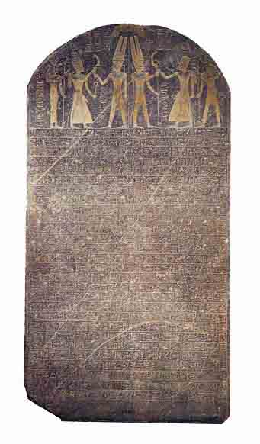
The Merneptah Stele 1207 BC
Israelites in Canaan
“CANAAN IS PLUNDERED . . . ISRAEL IS LAID WASTE, HIS SEED IS NOT.”
The mention of Israel appears slightly to the left of center in the second line from the bottom.
Biblical Archaeology Review 17:6, November/December 1991
Rainey’s Challenge

Slide 20
Gezer High Place
Exodus 24:4-8
“He (Moses) got up early the next morning and built an altar at the foot of the mountain and set up twelve stone pillars representing the twelve tribes of Israel.
…
“This is the blood of the covenant that the Lord has made with you in accordance with all these words.”
Ranging from 6 to 11 feet in height, ten monolithic stones stand in a row at the Gezer High Place. These stones are most likely “massebot” erected to commemorate a covenant.
Biblical Archaeology Review 41:1, January/February 2015
Commemorating a Covenant

